Slide 1
Understanding Azure API Management

Slide 2
Agenda (160 min)
09:00-10:20 Understanding Azure API Management
05 min Introduction - Say hello.
15 min Presentation - Let's talk about API-M in general but also how it works
15 min Task 1 - Prerequisites - We use the portal and PowerShell inside the portal.
10 min Task 2 - Provisioning (Consumption)
20 min Task 3 - API import in 3 different ways
15 min Task 4 - Products and Subscriptions
10:20-10:40 Break
10:40-12:00 Policies in Azure API Management
20 min Presentation (and pre-requisites)
20 min Mocking
10 min Manipulating the response
20 min Conditions

Slide 3



API Gateway
Client Apps
API Management
Ext. Service 4
Service 1
Service 2
Service 3

Slide 4
Essence of API Management
Façade
Hide backends from frontends
Front door
Single point of ingress
Frictionless consumption
Self-service user onboarding
Move backends without impacting frontends
Re-architect backends without impact on frontends
Expose a subset of backend capabilities
Aggregate or slice backends into APIs
Modernize legacy backends
Decouple frontend developers with mocks
Route
Authenticate
Authorize
Throttle
Transform
Trace
Meter
Discover APIs
Learn how to use APIs
Try APIs without writing any code
Request and receive access to APIs
Download API specs, samples, and SDKs
Interact with the API provider
Get usage reports
Notes:
So what are the benefits of deploying API Management in front of your services. This comes down to the essence of API Management.
APIM creates a façade in front of your service clusters
APIM serves as a front door and a single point of ingress to your backend services. It is a reverse proxy that routes incoming requests to your backend services. You can handle all of our cross-cutting concerns in API management. Since all traffic goes through APIM, Azure also collects telemetry, so you can trace requests and meter the usage.
APIM also provides kind of self-service, so we can easily onboard developers that want to use our APIs.

Slide 5
What we can do with API Management
Package and publish APIs to developers and partners
Build an API façade for existing backend services
Add new capabilities to APIs
Protect APIs from misuse and abuse
Gain insights into API usage and health
On-board developers via a self-service portal
Ramp-up developers with docs, samples, and API console

Slide 6
How do we secure our APIs?
Enforce pre-access checks.
Prevent unauthorized access
Prevent excessive usage
Watch for abnormal activity

Slide 7
Main APIM usage at Vipps
Compose APIs
Coarse grained access control
Rate limiting
Notes:
We think APIM to be a very powerful and flexible tool with lots of great features.
The most important job of APIM in Vipps is for composing APIs across services running in AKS, serverless or elsewhere.
Another use is coarse grained access control. There is no need to allow traffic further into our systems if it can be stopped at the edge, but applications are ultimately responsible for their own access control.
We also use it for rate limiting, helping protect the rest of our infrastructure and increasing overall reliability.

Slide 8
Model

Slide 9



Products and APIs
Users
Products
APIs
Azure API Management
subscribes
Vipps Services
contains subset of
Service API
Vipps App
Service API
Service API
Service API
Service API
Service API
Service API
subscribes
Merchant Services
contains subset of
Merchants
Service API
Endpoint 1
Endpoint 2

Slide 10
Deployment Options
Portal
ARM
REST
PowerShell
Azure .NET SDK
Terraform
Pulumi
Ansible
Notes:
AzureRm

Slide 11
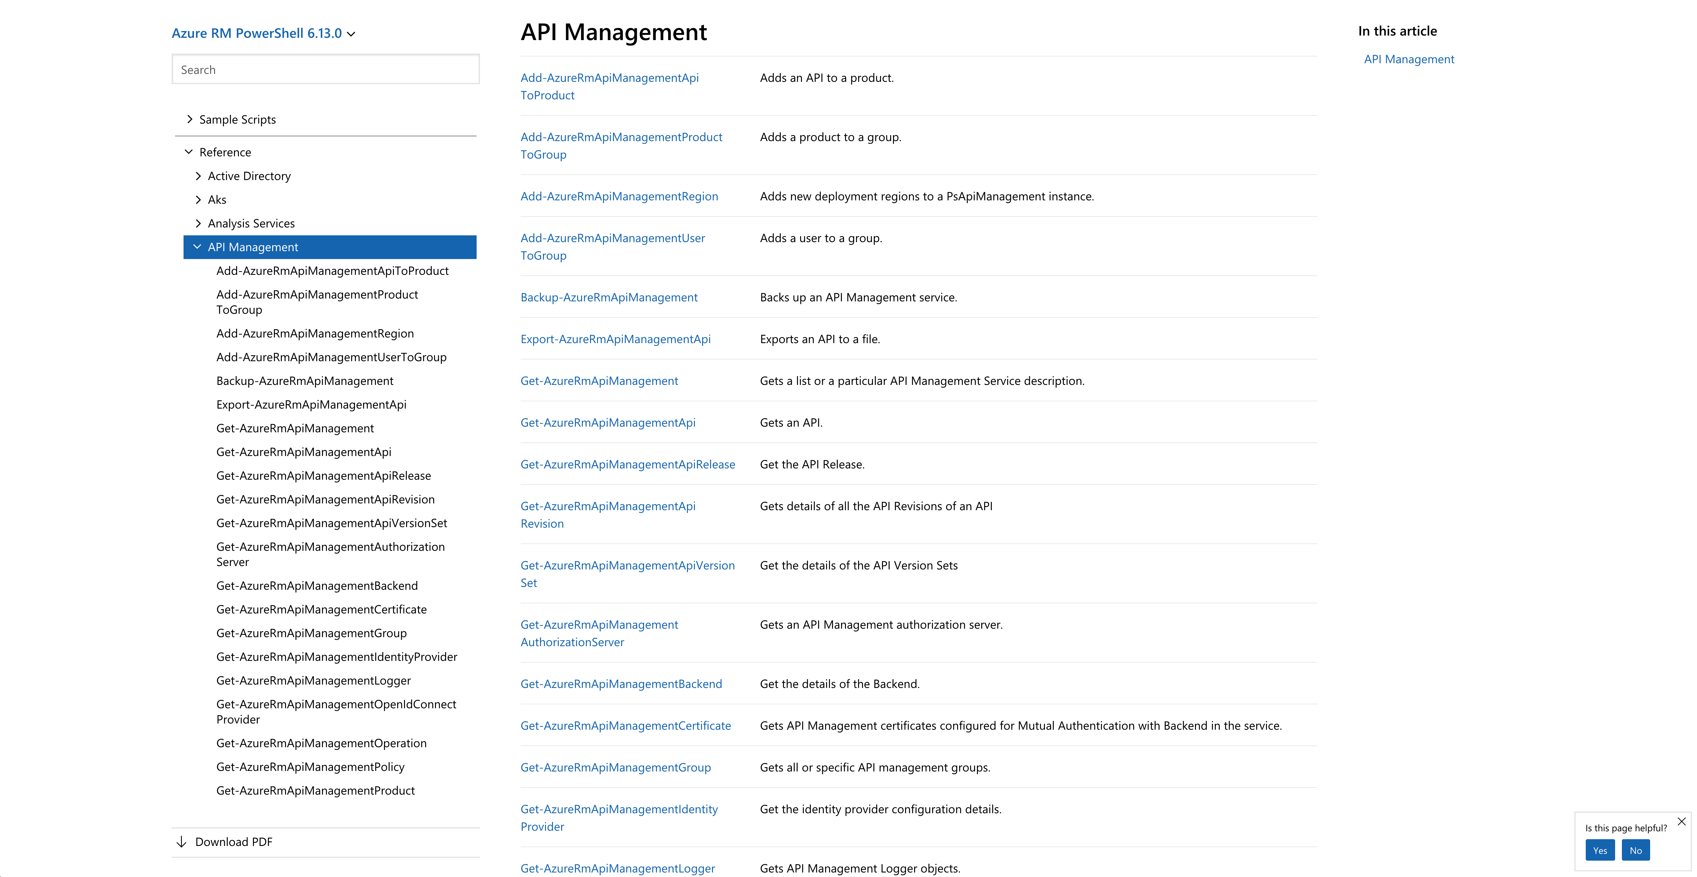
PowerShell module
Notes:
AzureRm

Slide 12
>

Slide 13
> $apimContext = New-AzApiManagementContext -ResourceGroupName "VIPPS-SIT-rg" -ServiceName "VIPPSSITapi02"
>

Slide 14
> Import-AzApiManagementApi -Context $apimContext -SpecificationFormat "Swagger" -SpecificationPath "/Users/sma/git/msbuild/files/2.20-swagger-canary.json" -Path "canary" -ApiId "canary"
ApiId : canary​
Name : Canary​
Description : This is the canary app. Its purpose is just to sit on a server and look pretty.​
ServiceUrl : ​
Path : canary​
ApiType : http​
Protocols : {Https}​
AuthorizationServerId : ​
AuthorizationScope : ​
SubscriptionKeyHeaderName : Ocp-Apim-Subscription-Key​
SubscriptionKeyQueryParamName : subscription-key​
ApiRevision : 1​
ApiVersion : ​
IsCurrent : True​
IsOnline : False​
Id : /subscriptions/123456-1234-1234-1234-12345678/resourceGroups/VIPPS-BUILD-rg/providers/Microsoft.ApiManagement/service/VIPPSBUILDapi02/apis/canary​
ResourceGroupName : VIPPS-BUILD-rg​
ServiceName : VIPPSBUILDapi02​
​
​

Slide 15
>

Slide 16
> Get-AzApiManagementApi -Context $apimContext -ApiId "canary"
ApiId : canary​
Name : Canary​
Description : This is the canary app. Its purpose is just to sit on a server and look pretty.​
ServiceUrl : ​
Path : canary​
ApiType : http​
Protocols : {Https}​
AuthorizationServerId : ​
AuthorizationScope : ​
SubscriptionKeyHeaderName : Ocp-Apim-Subscription-Key​
SubscriptionKeyQueryParamName : subscription-key​
ApiRevision : 1​
ApiVersion : ​
IsCurrent : True​
IsOnline : False​
Id : /subscriptions/123456-1234-1234-1234-12345678/resourceGroups/VIPPS-BUILD-rg/providers/Microsoft.ApiManagement/service/VIPPSBUILDapi02/apis/canary​
ResourceGroupName : VIPPS-BUILD-rg​
ServiceName : VIPPSBUILDapi02​
​
​

Slide 17
>

Slide 18
> Set-AzApiManagementPolicy -Context $apimContext -ApiId "canary -PolicyFilePath "/Users/sma/git/msbuild/files/2.20-canary.policy"
>

Slide 19
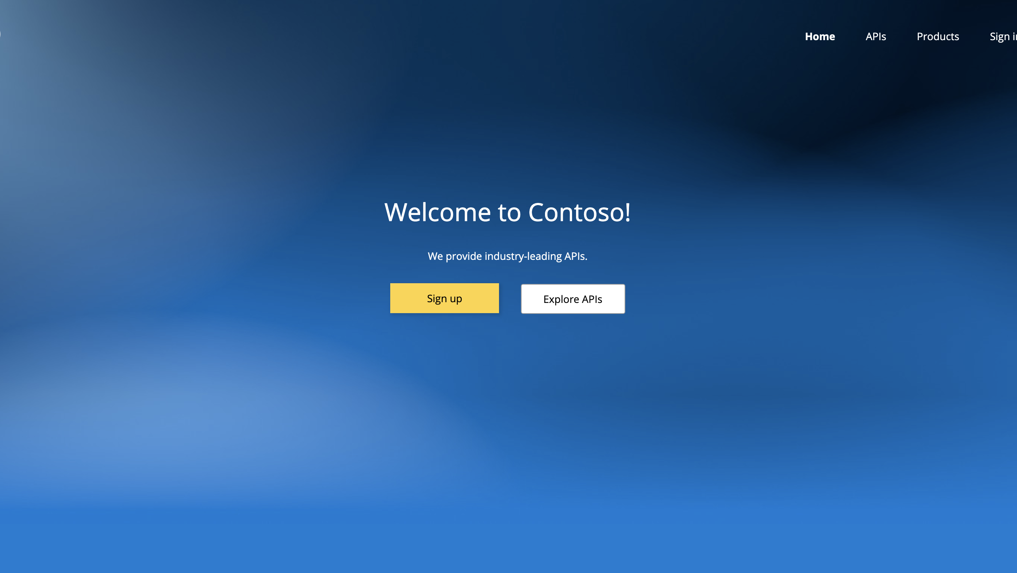

Slide 20
Let’s do some work ...
Notes:
Swagger https://petstore.swagger.io/ Portal / Management portal SKU Versioning Groups
Named Values
VSCode extension
#tmp-apim-ws-2

Slide 21
Task 1: Setup (together)
Make sure you can open a console from within the Azure Portal. Create then a resource group where you will deploy APIM to.
Task 2: Provision an instance of Azure API Management
Use PowerShell from the console in the Azure Portal. Provision an instance of APIM and make sure that whatever you will provision in this workshop will be deleted later together. Choose the purchasable Stock Keeping Unit (SKU) that bills per execution.
Task 3: Deploy 3 APIs in 3 different ways
In this task we'll deploy 3 APIs that we will need in the task that follows.
Deploy the famous conference API (https://conferenceapi.azurewebsites.net/?format=json ) to your APIM instance with PowerShell and test it from your favorite browser.
Deploy the petstore api (https://petstore.swagger.io/v2/swagger.json ) to your APIM instance directly from within the Azure Portal.
Create an own API called payments API with a basic GET endpoint directly from within in the Azure Portal. This API won't do much since it is missing an actual implementation yet. We will fix this in a later task.
Task 4: Secure your APIs
There are two clients. One client is an iOS developer that has written an App that shows Microsoft conferences. He needs only access to your conference API. The other client represents your own Android App that implements a pet store. This client need access to the petstore API and the payments API. In this task you will need to look at products.

Slide 22
Policies.

Slide 23
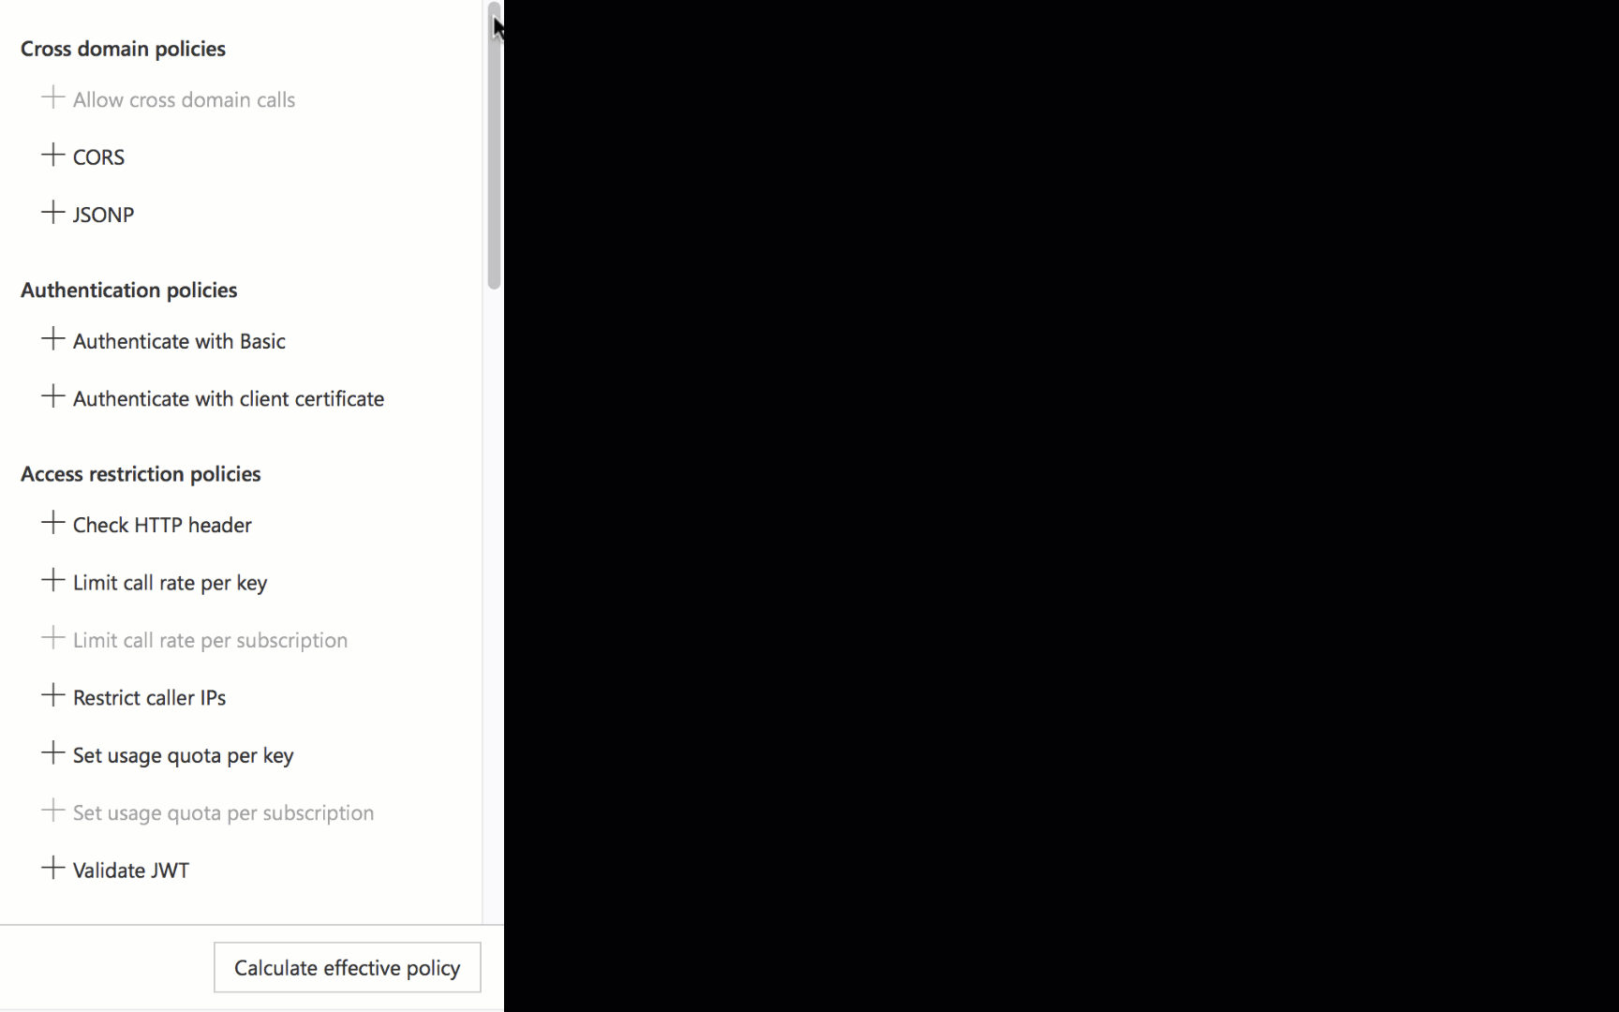
What are policies for?
Encapsulate common API management functions
Access control, Protection, Transformation, Caching, …
Mutate request context or change API behavior
Set in the inbound and outbound directions
Can be triggered on error
Applied at a variety of scopes
Header validation
Mocking
Rate limiting
Monetizing websites

Slide 24
Where can I set policies, and how do they work?
APIM Policy
Header validation
Mocking
Rate limiting
Monetizing websites
Global, Product, API, and Operation
Client
Inbound
Backend
Service
Outbound
OnError

Slide 25
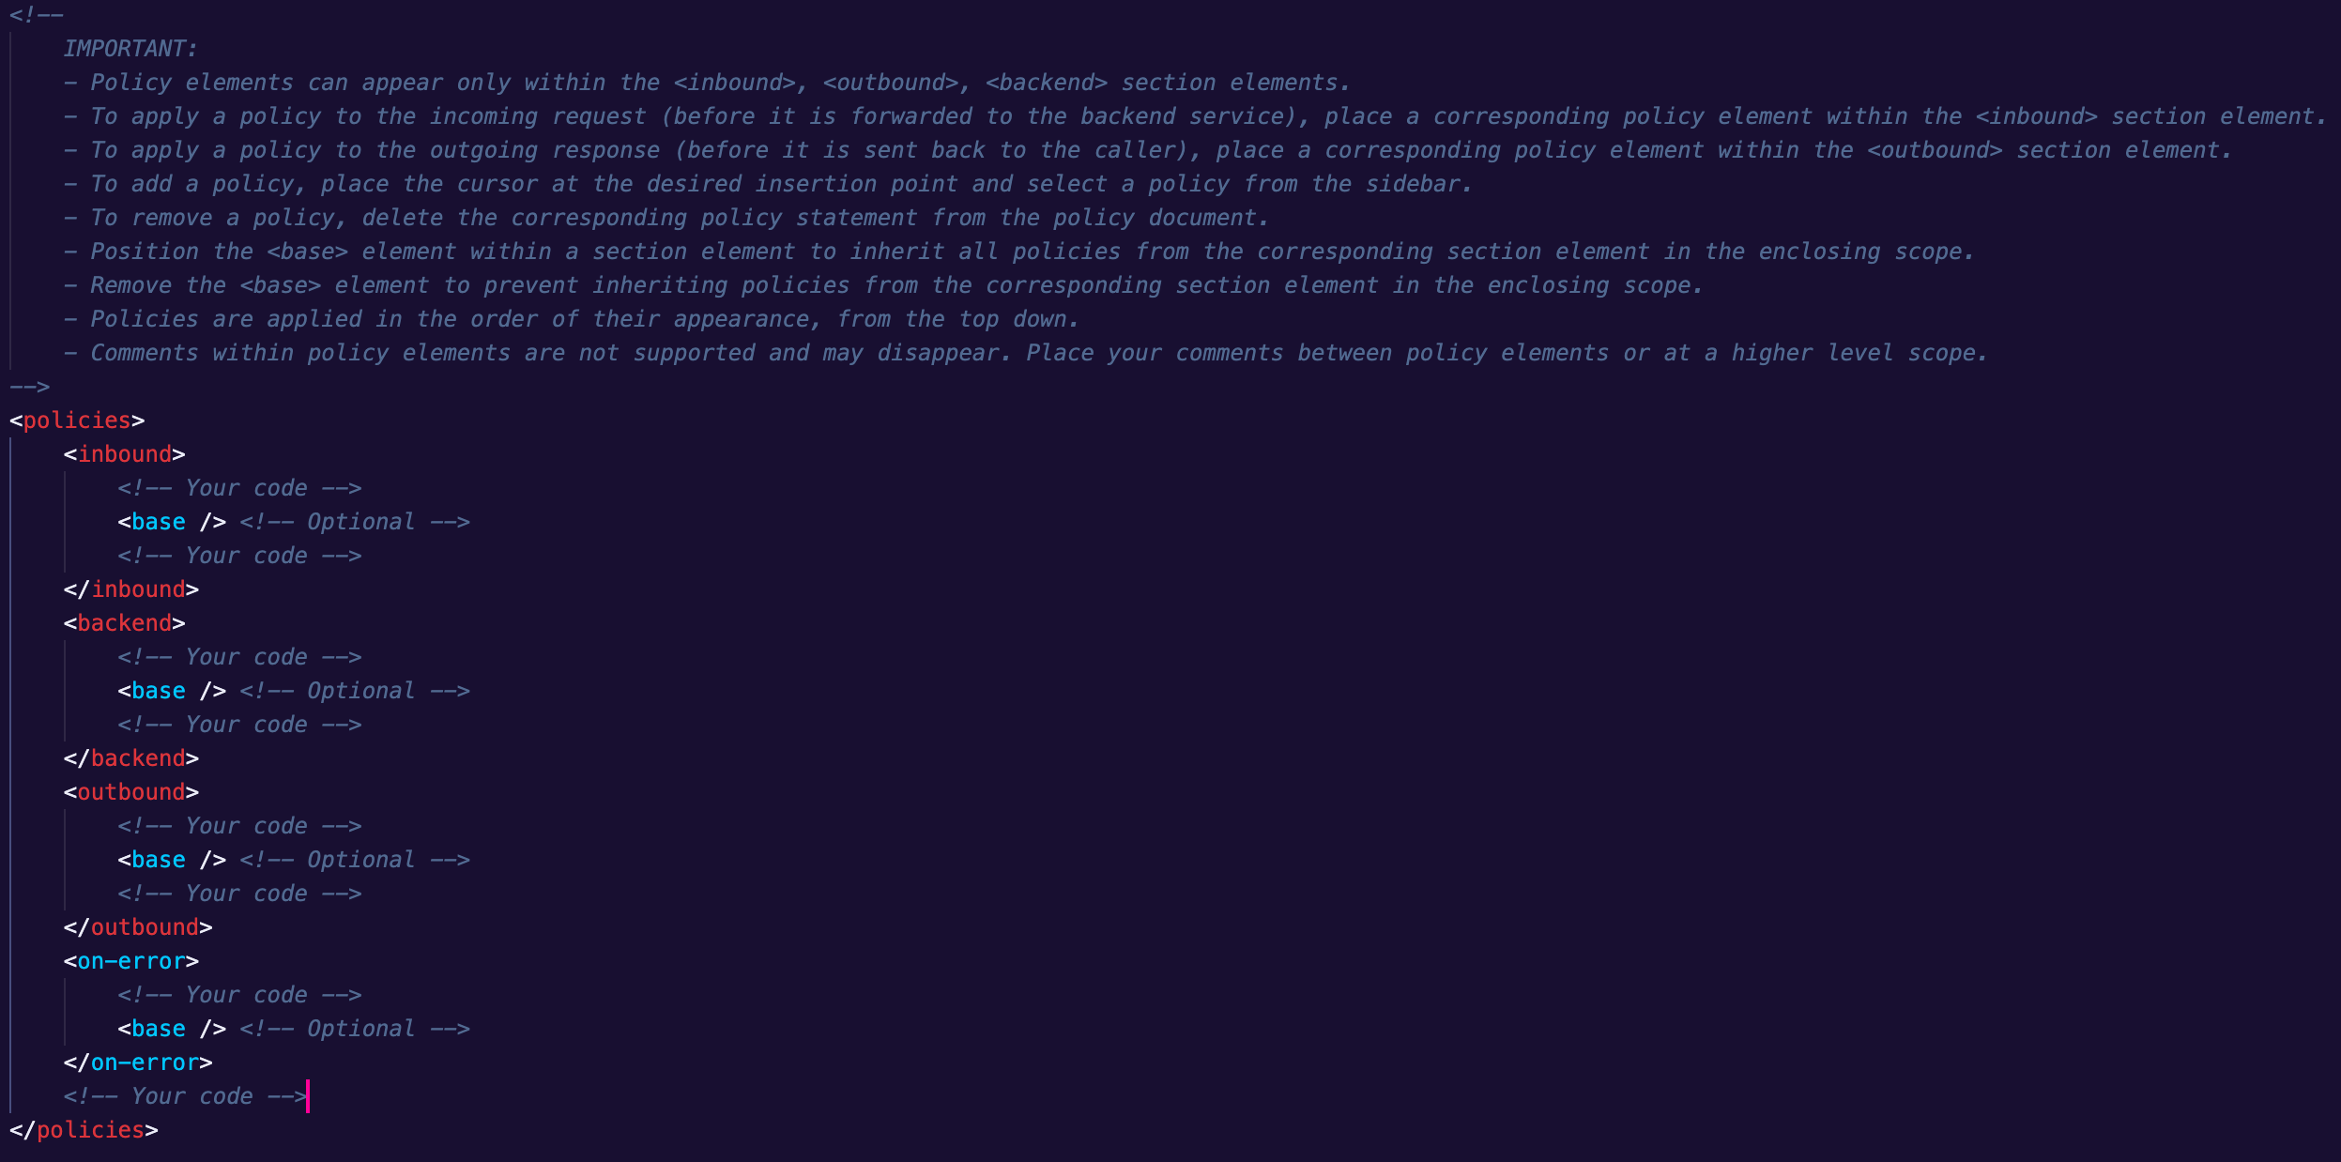
Global
Product
API
Operation

Slide 26
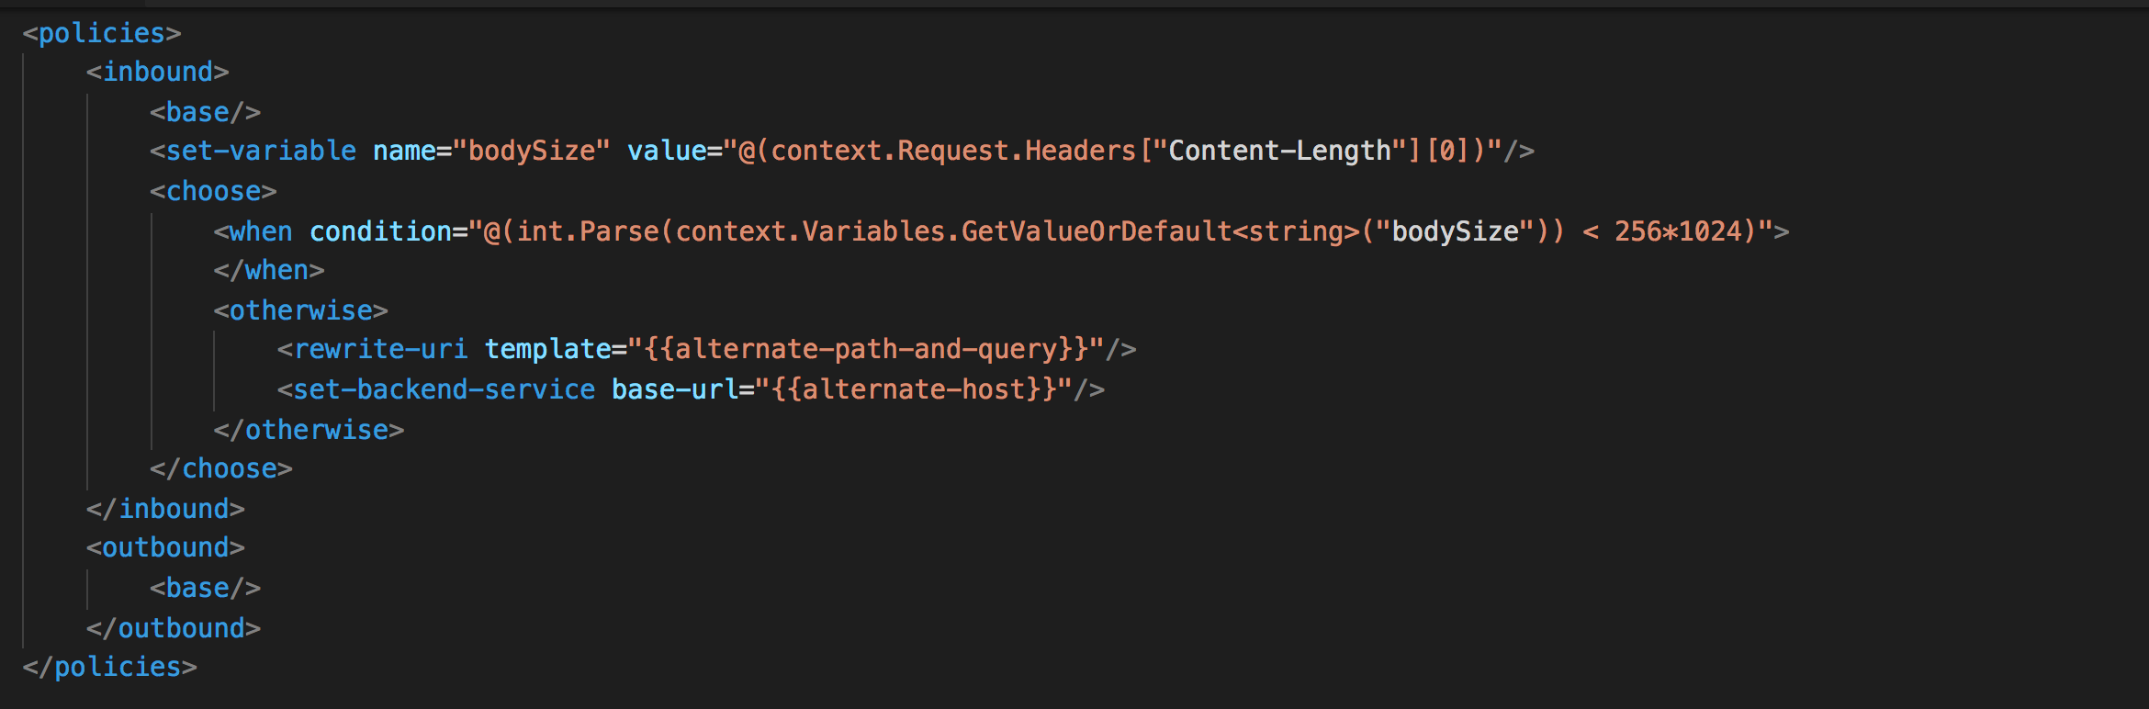
In what language do we code policies?
C# “snippets” used with policies
Read-only access to the request context
Can use whitelisted .NET types
Keep secrets and “magic” strings out of policies
Add semantics, if named well
Enable a single point of change
Provide environment-specific values

Slide 27
Basic API policy
<policies>
<inbound>
<base />
<set-backend-service base-url="{{AKSBackendUrl}}/payments/" />
</inbound>
<backend>
<base />
</backend>
<outbound>
<base />
</outbound>
</policies>

Slide 28
Mock template to include
<choose>
<when condition=”BOOLEAN">
<return-response>
<set-status code="400" reason="Bad Request" />
<set-header name="Content-Type" exists-action="override">
<value>application/json;charset=UTF-8</value>
</set-header>
<set-body>{"kind": "unsupported"}</set-body>
</return-response>
</when>
</choose>

Slide 29
Let’s do some work again ...
Notes:
Where do I find some policy tutorials?
What is the common way of debugging a policy?
How does VS Code support policies?
Where is the policy documentation?

Slide 30
Task 5: Mock the payments API
The payments API doesn't have an implementation yet. In this task we will mock its response with policies. To make it easy to change the response text later, we define the response text as a placeholder. We use named values for that.
Task 6: Append header to the response
Cutomers using our API Management instance will need to pay for the services they use. Once a month, they get a report about the usage per cost center. The problem for the customers today is that they don’t know what cost center the petstore belongs in. Let’s change that by appending a «CostCenter»-header to the response. The value can be anything.
Task 7: Blacklist IPs
We have one blacklisted IP address that we want to prevent from using all services coming through API Management. We will add a policy to our instance that will prevent this IP from accessing all of our services.

Slide 31
APIM maintenance

Slide 32
APIM maintenance tasks
Enable VNET connection
Configure APIM to send logs to Application Insight
Configure APIM to send logs to Event Hub
Backup and Restore
Managing custom domains with SSL certificates
Upgrade and scale (for non consumption plans)
Notes:
AzureRm

Slide 33
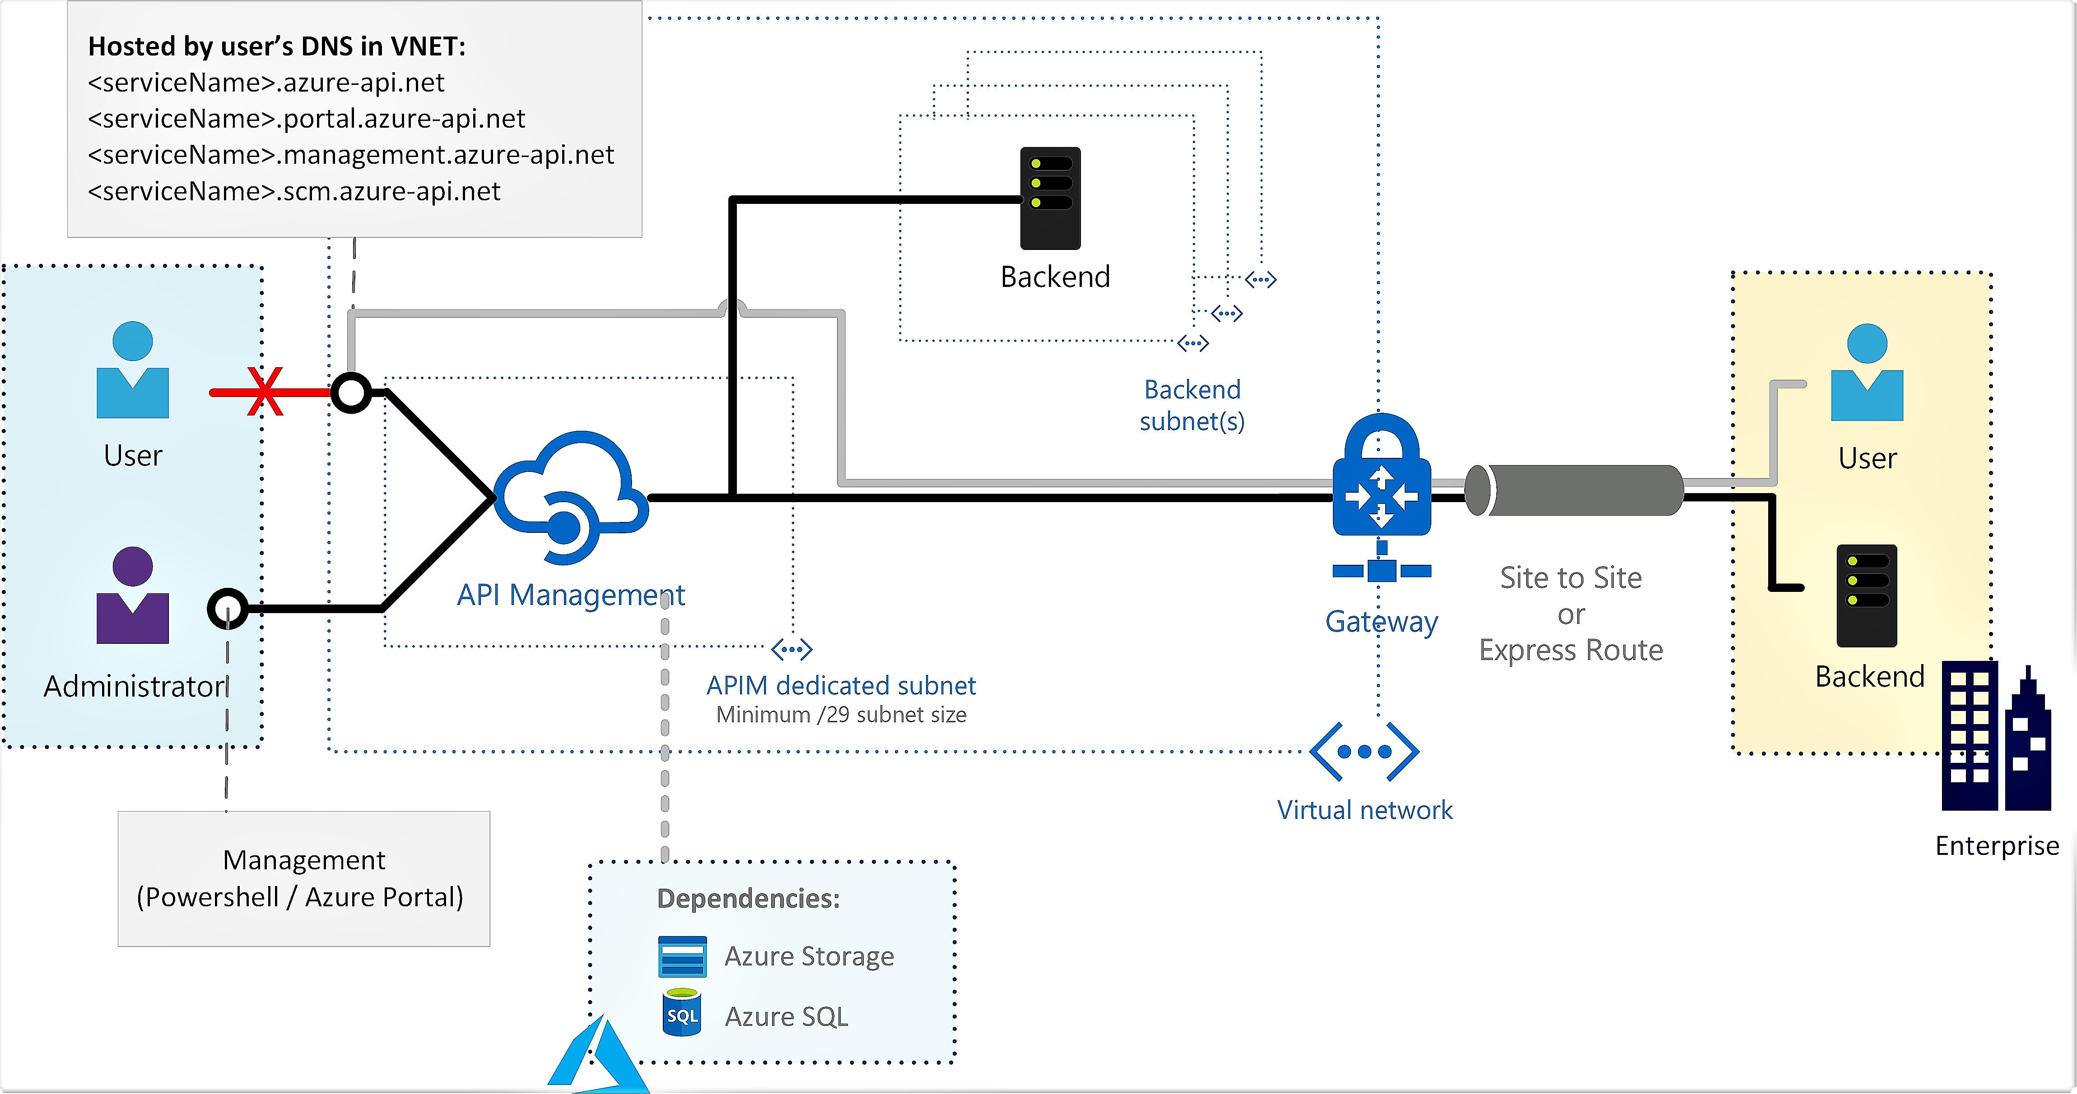
Enable VNET connection
Only supported at Premium sku
Can be configured from the portal
Internal and External
https://docs.microsoft.com/en-us/azure/api-management/api-management-using-with-vnet
Notes:
AzureRm

Slide 34
Configure APIM to send logs to Event Hub
Create new Event Hub namespace
New-AzEventHubNamespace
New-AzEventHub
Add EventHub Logger
New-AzApiManagementLogger -ConnectionString
Configure log-to-eventhubs policies
<log-to-eventhub>
https://docs.microsoft.com/en-us/azure/api-management/api-management-howto-log-event-hubs
https://docs.microsoft.com/en-us/azure/api-management/api-management-log-to-eventhub-sample
Notes:
AzureRm

Slide 35
Configure APIM to send logs to Application Insight
Create Application Insight
New-AzApplicationInsights
Add Application Insight Logger
New-AzApiManagementLogger -InstrumentationKey
Enable Application Insights logging for your API
single API logger
logger for all APIs
! Logging all events to AI may have serious performance implications, depending on incoming requests rate.
https://docs.microsoft.com/en-us/azure/api-management/api-management-howto-app-insights
Notes:
https://portal.azure.com/#@vipps.no/resource/subscriptions/f8fd3f8e-49d5-4c8e-8d21-f7e0bbbde0df/resourceGroups/VIPPS-MT1-rg/providers/microsoft.insights/components/vipps-apim-mt/applicationMap

Slide 36
Backup and Restore
Not supported at consumption plan
Backup to storage account
Powershell Backup-AzApiManagement – can be automated with runbook
Rest API – can be automated with Logic App
Restore from storage account
https://docs.microsoft.com/en-us/azure/api-management/api-management-howto-disaster-recovery-backup-restore
Notes:
AzureRm

Slide 37
Managing custom domains
Default dns:
Gateway - <apim-service-name>.azure-api.net
Portal - <apim-service-name>.portal.azure-api.net
Management - <apim-service-name>.management.azure-api.net
SCM - <apim-service-name>.scm.azure-api.net
Consumption plan – can only change Gateway
Premium – tier supports setting multiple host names for the Gateway
SSL certificate can be uploaded form the pfx file or referenced from kevaylt
https://docs.microsoft.com/en-us/azure/api-management/scripts/powershell-setup-custom-domain
Notes:
AzureRm

Slide 38
Managing SSL certificates
Default dns:
Gateway - <apim-service-name>.azure-api.net
Portal - <apim-service-name>.portal.azure-api.net
Management - <apim-service-name>.management.azure-api.net
SCM - <apim-service-name>.scm.azure-api.net
Consumption plan – can only change Gateway
Premium – tier supports setting multiple host names for the Gateway
https://docs.microsoft.com/en-us/azure/api-management/scripts/powershell-setup-custom-domain
Notes:
AzureRm

Slide 39
Security
You can secure back-end services using client certificate
You can secure your APIs using client certificate authentication (with policies)
Checking the issuer and subject
Checking the thumbprint
Checking a thumbprint against certificates uploaded to API Management
Protect an API by using OAuth 2.0 with Azure Active Directory and API Management
https://docs.microsoft.com/en-us/azure/api-management/api-management-howto-mutual-certificates
https://docs.microsoft.com/en-us/azure/api-management/api-management-howto-mutual-certificates-for-clients
https://docs.microsoft.com/en-us/azure/api-management/api-management-howto-protect-backend-with-aad
Notes:
AzureRm

Slide 40
Upgrade and scale
You can choose between 4 tiers: Developer, Basic, Standard and Premium
Basic – up to 2 units
Standard – up to 4 units
Premium - enables to distribute a single instance across any number of Azure regions (DR)
Autoscaling (only Standard and Premium)
Uses Azure Monitor and rules based on metrics
Can be configured to scale in and scale out
https://docs.microsoft.com/en-us/azure/api-management/upgrade-and-scale
https://docs.microsoft.com/en-us/azure/api-management/api-management-howto-autoscale
Notes:
AzureRm

Slide 41
Let’s do some work again ...

Slide 42
Task 6: Configure APIM to send logs to Event Hub
We need to collect logs to event hub for further processing, therefore we need to do the following:
Create EventHub namespace with EventHub called apimlogs
Add new APIM EventHub logger and use EventHub created at #1
Configure that all inbound calls for all APIS send the following data to EventHub: timestamp (in UtcNow format), request id and operation name
Task 7: Configure APIM to send logs to Application Insight
To simplify debugging we can send APIM logs to Aplication Insight. Let’s create new Application Insight instance and configure APIM that all APIs logs request data to Application Insight.

